Slide 1
Familiarize yourself with phishing attacks
HR and Marketing Departments are the most at risk.

Slide 2
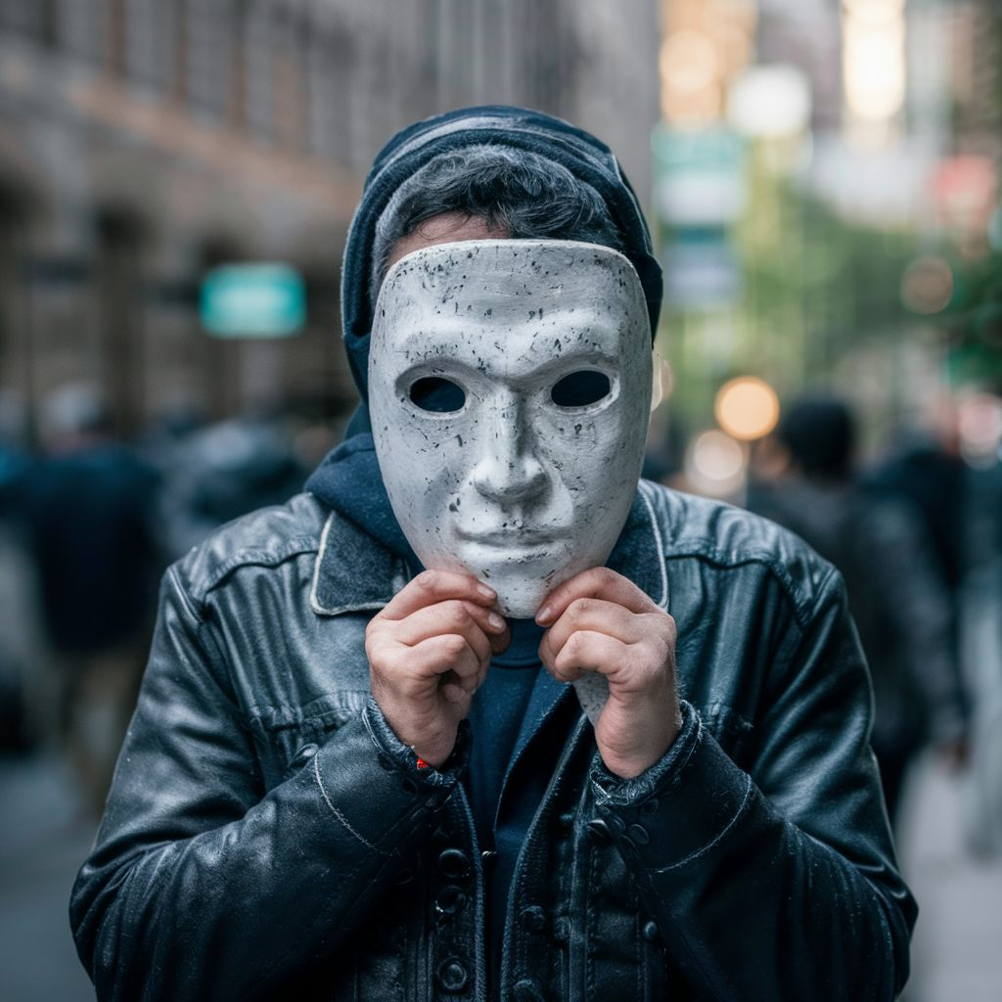
What is phishing?
Phishing is a cybercrime technique used by malicious actors, they pretend to be someone they’re not to trick individuals into revealing sensitive information such as passwords, credit card numbers, or personal details. Phishing attacks often occur through email, but they can also happen via text messages, phone calls, or social media platforms.
Example: A phishing email disguised as a message from a bank, requesting the recipient to click on a link and provide their login credentials to verify their account.

Slide 3

Learn to spot phishing emails
Spotting phishing emails requires careful attention to detail and awareness of common red flags.
Check the Sender's Email Address
Look for Generic Greetings
Examine Links and Attachments
Watch for Urgency or Threats

Slide 4
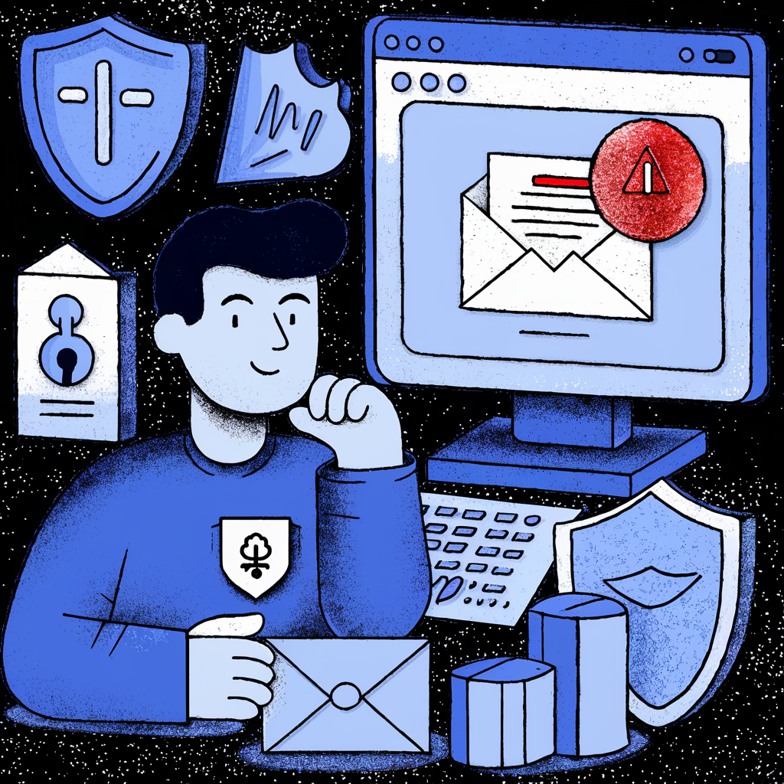
How do we stop getting phished?
Stopping phishing requires a combination of technology, education, and vigilance.
Confirm authenticity of any links before clicking on them
Use Email Filtering like spam filters
Two-Factor Authentication (2FA) on sensitive accounts
Report Suspicious Activity

